Slide 1


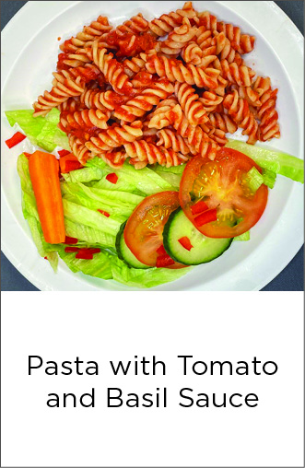


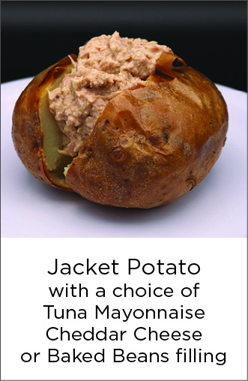
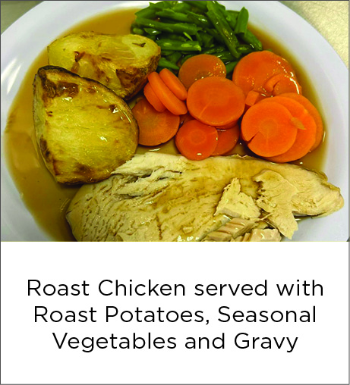
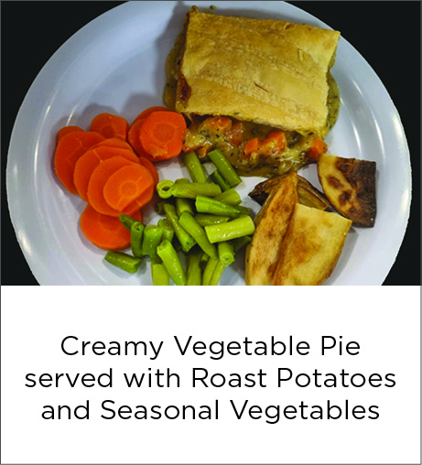
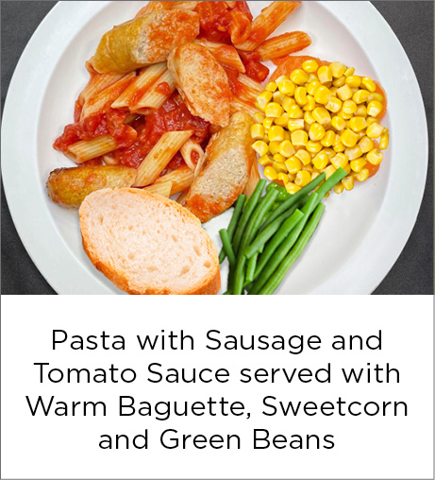



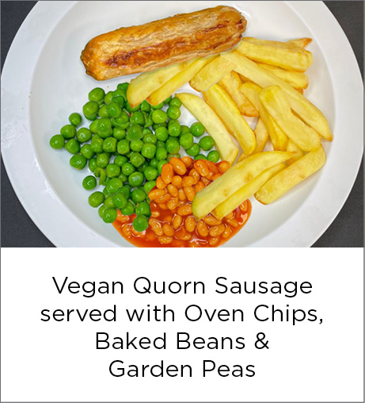
South Wonston Primary - Week 1 Menu
Week commencing: 7th September, 28th September, 19th October
Insert dates here

Slide 2
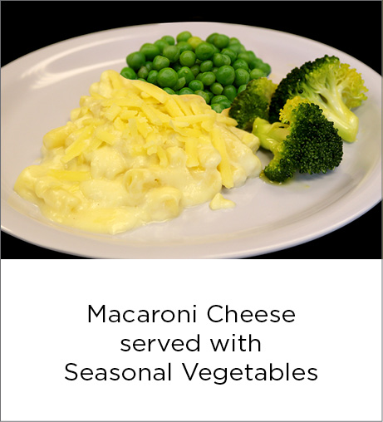

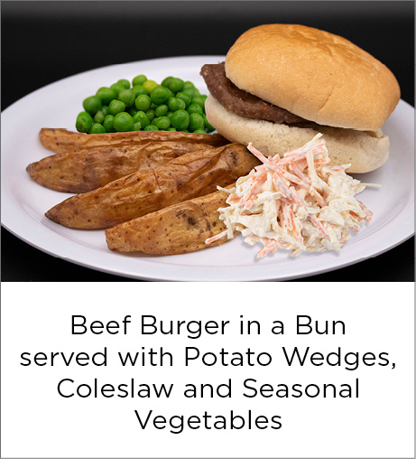
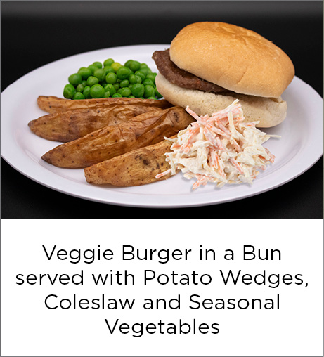






South Wonston Primary - Week 2 Menu
Week commencing: 14th September, 5th October, 26th October

Slide 3

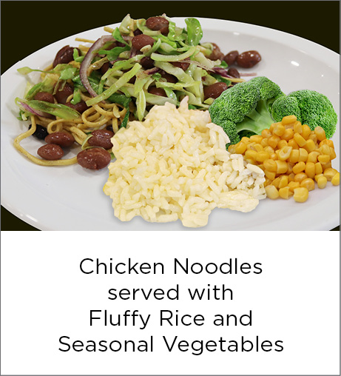




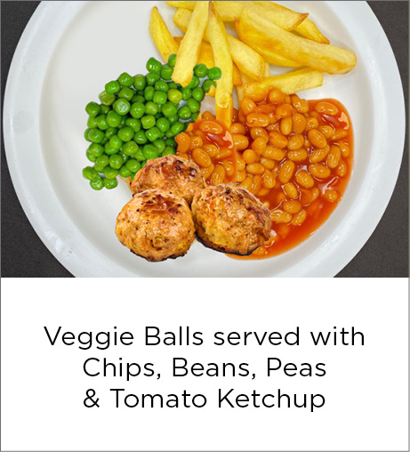
South Wonston Primary - Week 3 Menu
Week commencing: 1st September, 21st September, 12th October

